Slide 1
Architectural Styles

Slide 2
Definitions of Architectural Style
An architectural style is a named collection of architectural design decisions that
  are applicable in a given development context
  constrain architectural design decisions that are specific to a particular system within that context
  elicit beneficial qualities in each resulting system.
Recurring organizational patterns & idioms
  Established, shared understanding of common design forms
  Mark of mature engineering field (Shaw & Garlan)
Abstraction of recurring composition & interaction characteristics in a set of architectures (Medvidovic & Taylor)

Slide 3
Basic Properties of Styles
A vocabulary of design elements
  Component and connector types; data elements
  e.g., pipes, filters, objects, servers
A set of configuration rules
  Topological constraints that determine allowed compositions of elements
  e.g., a component may be connected to at most two other components
A semantic interpretation
  Compositions of design elements have well-defined meanings
Possible analyses of systems built in a style

Slide 4
Benefits of Using Styles
Design reuse
  Well-understood solutions applied to new problems
Code reuse
  Shared implementations of invariant aspects of a style
Understandability of system organization
  A phrase such as “client-server” conveys a lot of information
Interoperability
  Supported by style standardization
Style-specific analyses
  Enabled by the constrained design space
Visualizations
  Style-specific depictions matching engineers’ mental models

Slide 5
Style Analysis Dimensions
What is the design vocabulary?
  Component and connector types
What are the allowable structural patterns?
What is the underlying computational model?
What are the essential invariants of the style?
What are common examples of its use?
What are the (dis)advantages of using the style?
What are the style’s specializations?

Slide 6
Some Common Styles
Call & return systems
  Main program and subroutines
  Object-oriented
  Hierarchical layers
Data-flow systems
  Batch sequential
  Pipe and filter
Data-centered systems (Repositories)
  Databases
  Blackboard
  Hypertext systems
Virtual Machines
  Interpreters
  Rule based systems
Independent components
  Communicating processes
  Event-based
  Publish-subscribe
Peer-to-peer
“Derived” styles
  CORBA

Slide 7
Object-Oriented Style
Components are objects
  Data and associated operations
Connectors are messages and method invocations
Style invariants
  Objects are responsible for their internal representation integrity
  Internal representation is hidden from other objects
Advantages
  “Infinite malleability” of object internals
  System decomposition into sets of interacting agents
Disadvantages
  Objects must know identities of servers
  Side effects in object method invocations (if object’s identity changes)

Slide 8
Layered Style
Hierarchical system organization
  “Multi-level client-server”
  Each layer exposes an interface (API) to be used by above layers
Each layer acts as a
  Server: service provider to layers “above”
  Client: service consumer of layer(s) “below”
Connectors are protocols of layer interaction
Example: operating systems
Virtual machine style results from fully opaque layers

Slide 9
Layered Style (cont’d)
Advantages
  Increasing abstraction levels
  Evolvability
  Changes in a layer affect at most the adjacent two layers
    Reuse
  Different implementations of layer are allowed as long as interface is preserved
  Standardized layer interfaces for libraries and frameworks

Slide 10
Layered Style (cont’d)
Disadvantages
  Not universally applicable
  Performance
Layers may have to be skipped
  Determining the correct abstraction level

Slide 11
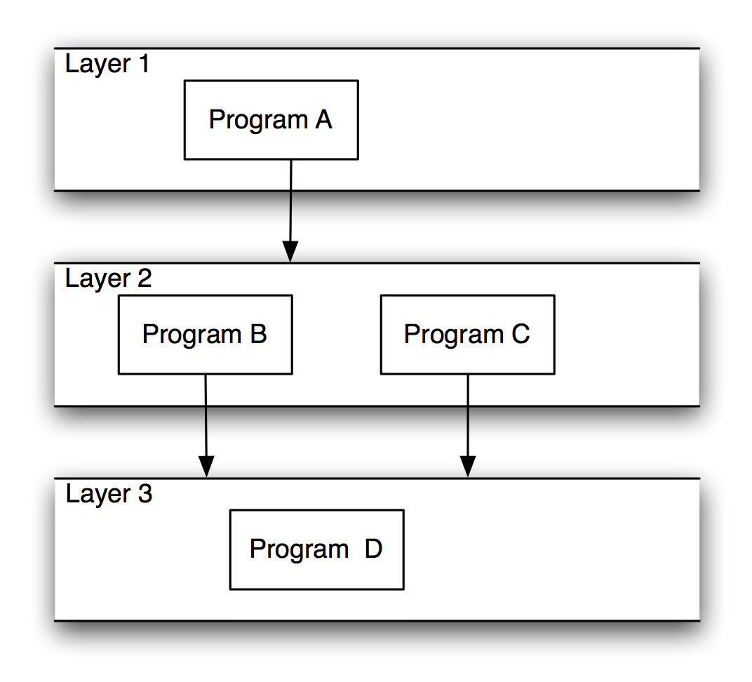
Layered Systems/Virtual Machines
Software Architecture: Foundations, Theory, and Practice; Richard N. Taylor, Nenad Medvidovic, and Eric M. Dashofy; © 2008 John Wiley & Sons, Inc. Reprinted with permission.

Slide 12
Client-Server Style
Components are clients and servers
Servers do not know number or identities of clients
Clients know server’s identity
Connectors are RPC-based network interaction protocols

Slide 13
Data-Flow Styles
Batch Sequential
  Separate programs are executed in order; data is passed as an aggregate from one program to the next.
  Connectors: “The human hand” carrying tapes between the programs, a.k.a. “sneaker-net ”
  Data Elements: Explicit, aggregate elements passed from one component to the next upon completion of the producing program’s execution.
Typical uses: Transaction processing in financial systems.
  “The Granddaddy of Styles”

Slide 14
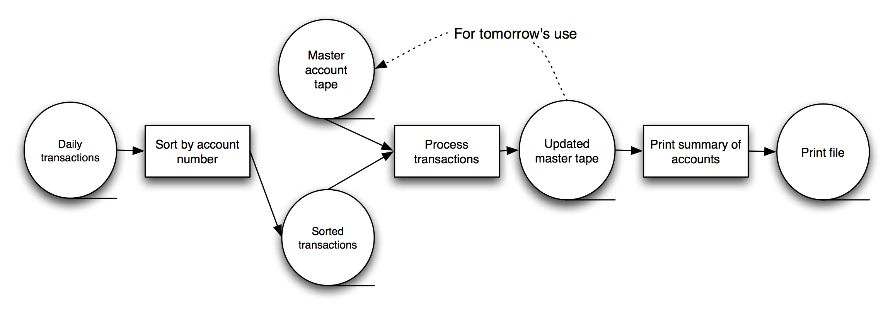
Batch-Sequential: A Financial Application
Software Architecture: Foundations, Theory, and Practice; Richard N. Taylor, Nenad Medvidovic, and Eric M. Dashofy; © 2008 John Wiley & Sons, Inc. Reprinted with permission.

Slide 15
Pipe and Filter Style
Components are filters
  Transform input data streams into output data streams
  Possibly incremental production of output
Connectors are pipes
  Conduits for data streams
Style invariants
  Filters are independent (no shared state)
  Filter has no knowledge of up- or down-stream filters
Examples
  UNIX shell signal processing
  Distributed systems parallel programming
Example: ls invoices | grep -e August | sort

Slide 16
Pipe and Filter (cont’d)
Variations
  Pipelines — linear sequences of filters
  Bounded pipes — limited amount of data on a pipe
  Typed pipes — data strongly typed
Advantages
  System behavior is a succession of component behaviors
  Filter addition, replacement, and reuse
    Possible to hook any two filters together
  Certain analyses
    Throughput, latency, deadlock
  Concurrent execution

Slide 17
Pipe and Filter (cont’d)
Disadvantages
  Batch organization of processing
  Interactive applications
  Lowest common denominator on data transmission

Slide 18
Compilers
Traditionally views as pipeline systems
  Lexical analysis, parsing, semantic analysis, and code generation.

Slide 19
Blackboard Style
Two kinds of components
  Central data structure — blackboard
  Components operating on the blackboard
System control is entirely driven by the blackboard state
Examples
  Typically used for AI systems
  Integrated software environments (e.g., Interlisp)
  Compiler architecture

Slide 20
Implicit Invocation Style
Event announcement instead of method invocation
  “Listeners” register interest in and associate methods with events
  System invokes all registered methods implicitly
Component interfaces are methods and events
Two types of connectors
  Invocation is either explicit or implicit in response to events
Style invariants
  “Announcers” are unaware of their events’ effects
  No assumption about processing in response to events

Slide 21
Implicit Invocation (cont’d)
Advantages
  Component reuse
  System evolution
    Both at system construction-time & run-time
Disadvantages
  Counter-intuitive system structure
  Components relinquish computation control to the system
  No knowledge of what components will respond to event
  No knowledge of order of responses

Slide 22
Integrated Development Environments (IDEs)
Think of the debugging process (use of breakpoints)
  How editors behaves on a breakpoint?
  How variables monitors behave on a breakpoint?
  How these components know when these are required?

Slide 23
Publish-Subscribe
Subscribers register/deregister to receive specific messages or specific content. Publishers broadcast messages to subscribers either synchronously or asynchronously.

Slide 24
Publish-Subscribe (cont’d)
Components: Publishers, subscribers, proxies for managing distribution
Connectors: Typically a network protocol is required. Content-based subscription requires sophisticated connectors.
Data Elements: Subscriptions, notifications, published information
Topology: Subscribers connect to publishers either directly or may receive notifications via a network protocol from intermediaries
Qualities yielded: Highly efficient one-way dissemination of information with very low-coupling of components

Slide 25
Event-Based Style
Independent components asynchronously emit and receive events communicated over event buses
Components: Independent, concurrent event generators and/or consumers
Connectors: Event buses (at least one)
Data Elements: Events – data sent as a first-class entity over the event bus
Topology: Components communicate with the event buses, not directly to each other.
Variants: Component communication with the event bus may either be push or pull based.
Highly scalable, easy to evolve, effective for highly distributed applications.

Slide 26
Peer-to-Peer Style
State and behavior are distributed among peers which can act as either clients or servers.
Peers: independent components, having their own state and control thread.
Connectors: Network protocols, often custom.
Data Elements: Network messages

Slide 27
KWIC (Key Word in Context)

Slide 28
KWIC
KWIC: “Key Words In Context"
the KWIC index system accepts an ordered set of lines
each line is an ordered set of words
each word is an ordered set of characters
any line may be “circularly shifted" by repeatedly removing the 1st word and appending it to the end of the line
the KWIC index system outputs a listing of all circular shifts of all lines in alphabetical order

Slide 29
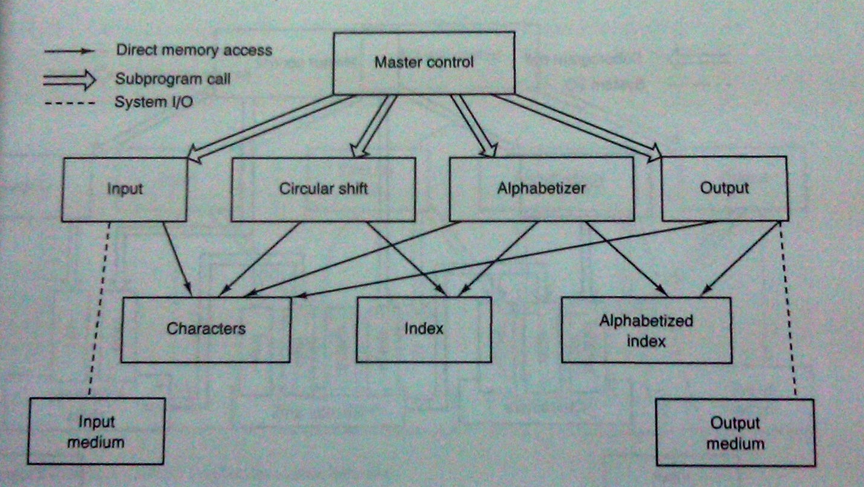
Criteria for Decomposition - 1

Slide 30
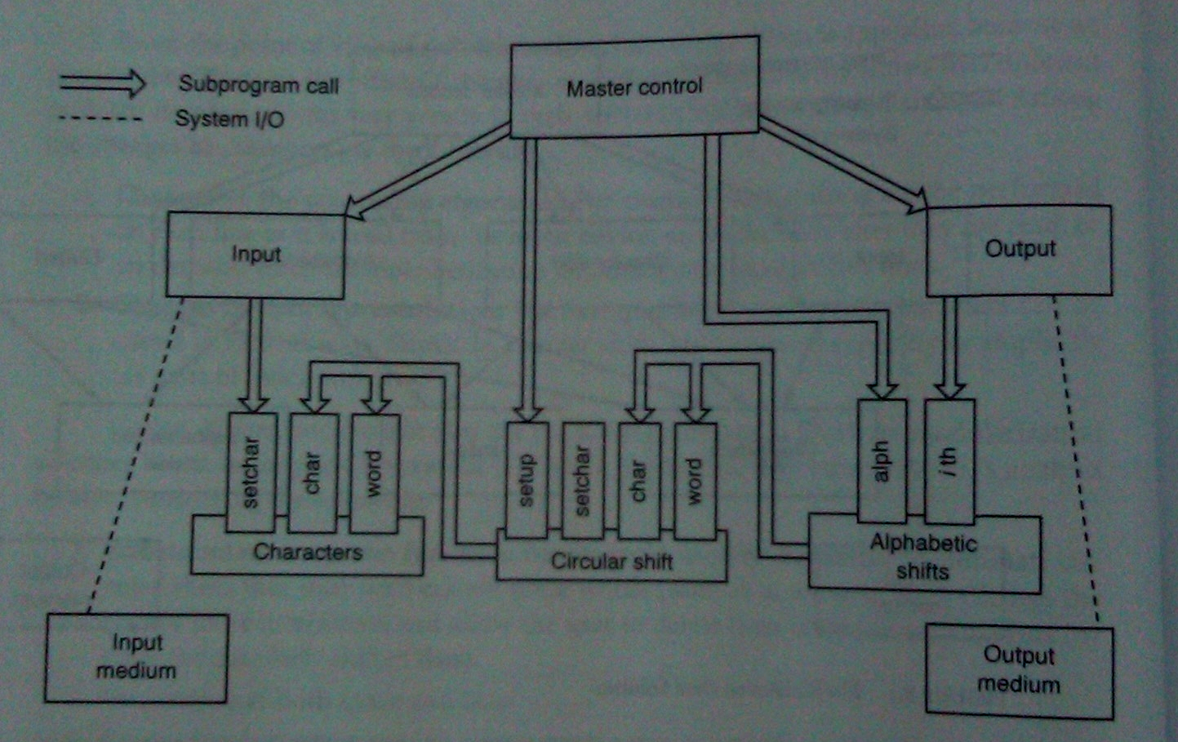
Criteria for Decomposition - 2

Slide 31
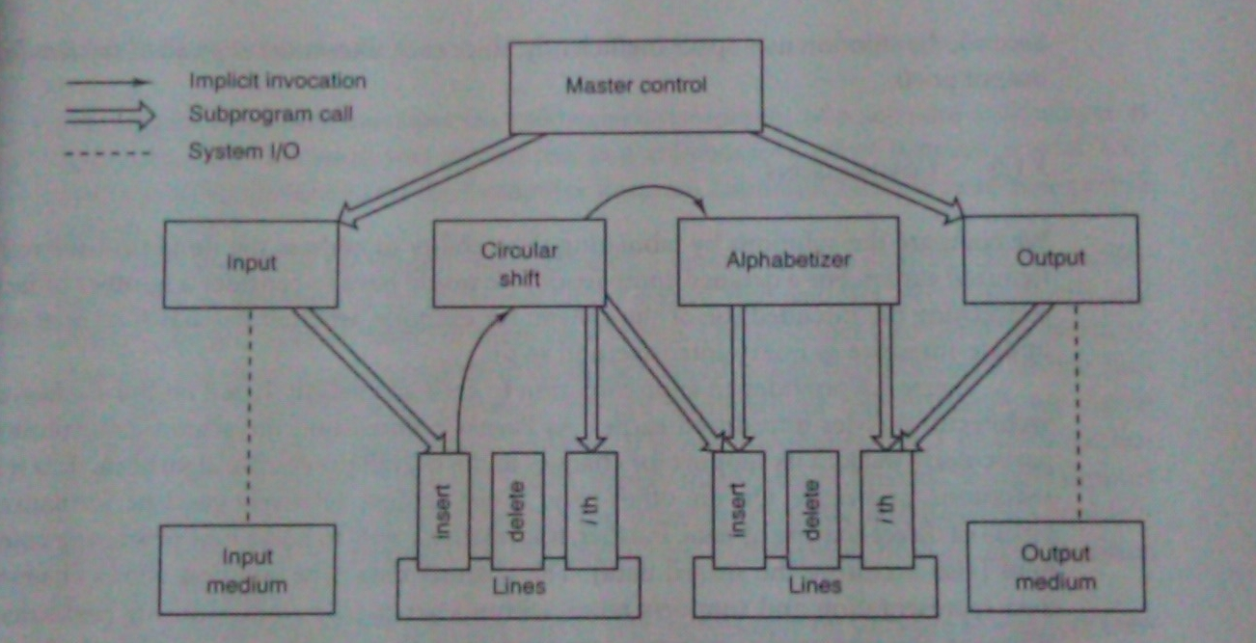
Criteria for Decomposition - 3

Slide 32
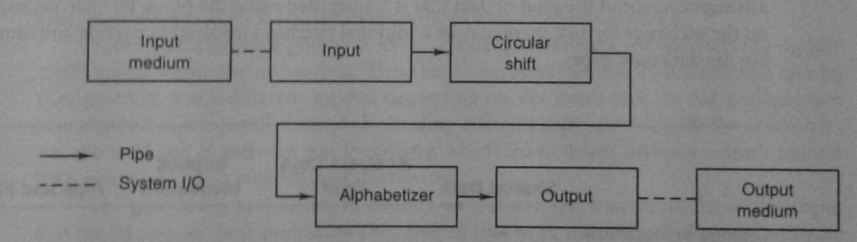
Criteria for Decomposition - 4

Slide 33
Criteria for Decomposition
1. Shared Data Solution
2. Abstract Data Type
3. Implicit Invocation Solution
4. Pipes and Filters

